Slide 1
TAPAS Project – Mid-Term Presentation
St.Gallen, 23rd October 2023
Group 5

Slide 2




The Team
Kaan Aydin
Michael Brülisauer
Daniel Leal
Stephan Nef

Slide 3
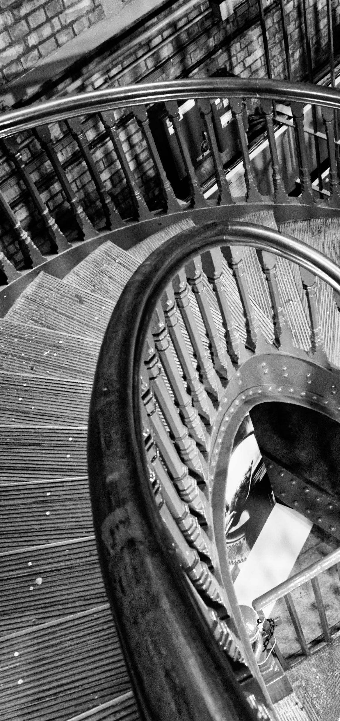






Software Architecture
Selected Architecture Decisions
Performance & Testing
Demonstration
Key Takeaways & Contributions
Agenda
Notes:
Event Storming Board, Architecture Characteristics, Architectural Styles, Service Design, and Application Flow

Slide 4




Software Architecture
Event Storming Board
Architecture Characteristics
Architectural Styles
Service Design
Application Flow
Selected Architecture Decisions
Performance & Testing
Demonstration
Key Takeaways & Contributions
Agenda

Slide 5
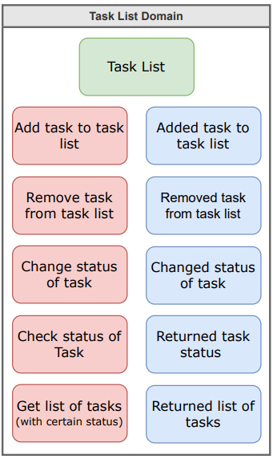
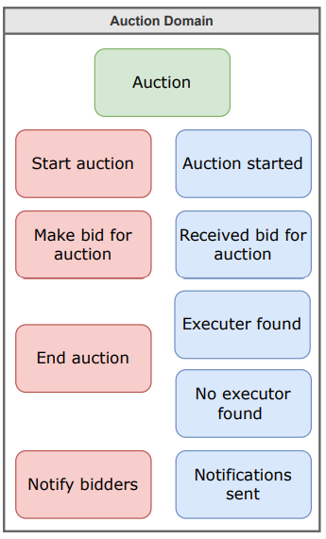
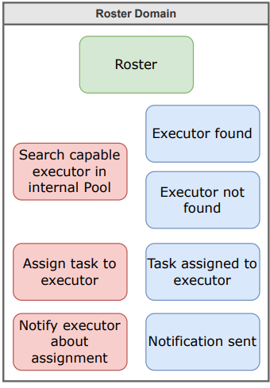
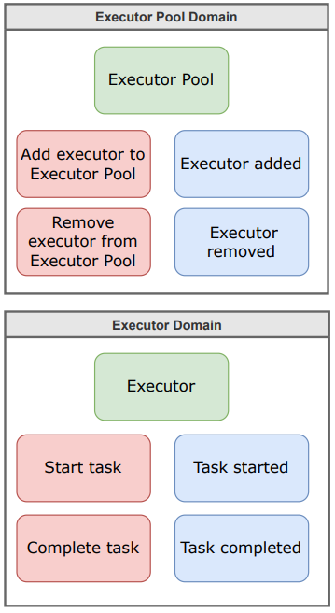
Event Storming Board | We identified 5 bounded contexts
1
2
3
4
5
Bounded Context
Aggregate
Event Trigger
Domain Event

Slide 6






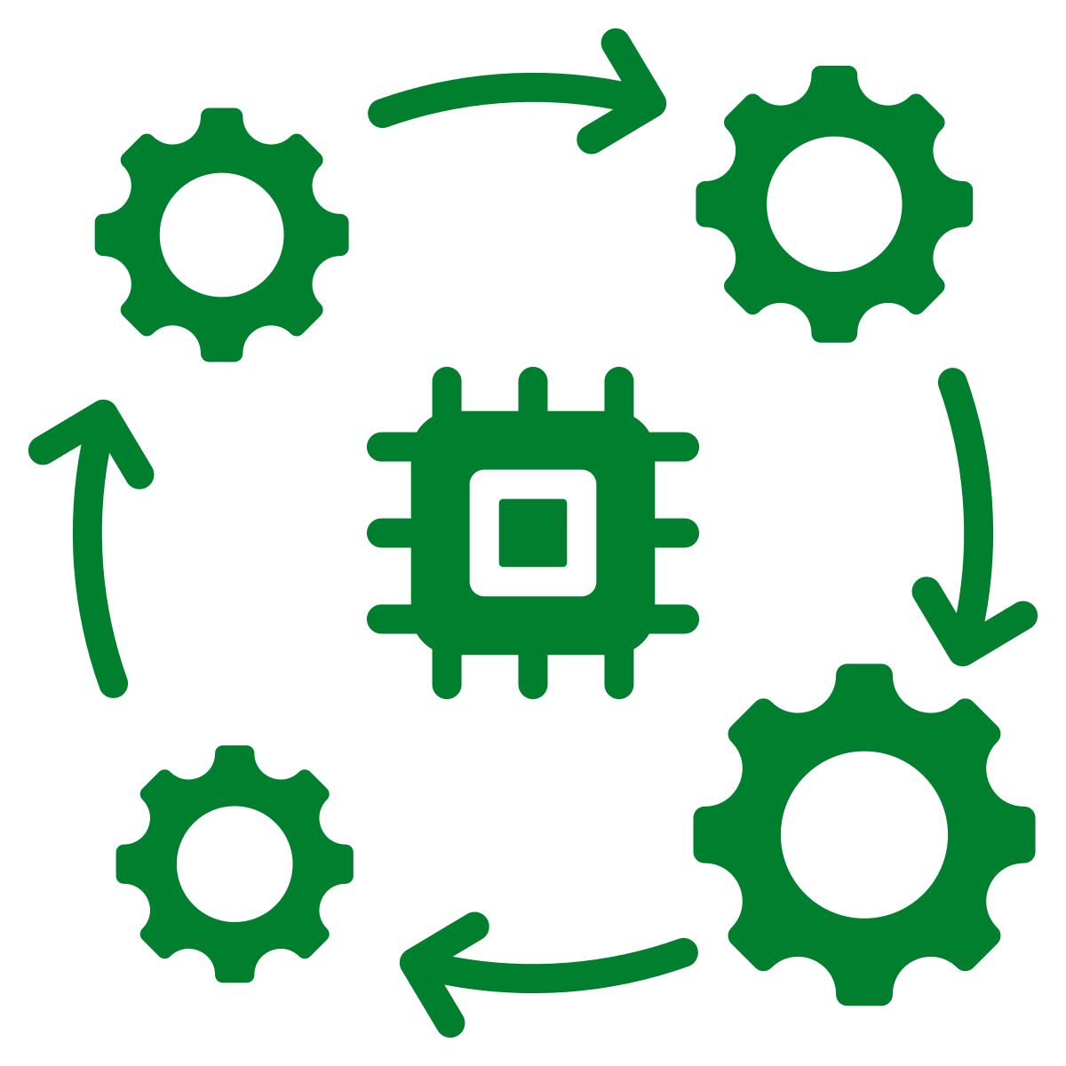
Top 3
Scalability
Each organization can have thousands of users adding Tasks to the organization's Task List
Recoverability
The assignment of tasks to executors should be preserved in case (parts of) the system fail
Elasticity
The performance of the system should degrade gracefully in the presence of heavy load.
Architecture Characteristics | Given the user and systems requirements, we selected seven driving characteristics
Fault Tolerance
The system’s operation should not be disrupted in case an Executor malfunctions or fails
Modularity
We can add new Executors while the system is running w/o affecting remaining parts of the system
Evolvability
Evolvability is key to support incremental changes throughout the semester across dimensions
Interoperability
Tasks for which no internal Executors are available need to be executed by external Executors
Notes:
We selected the driving characteristics based on the following statements from the exercise sheet:
Scalability: "Each organization can have thousands of users adding Tasks to the organization's Task List”
Elasticity: "The performance of the system should degrade gracefully in the presence of heavy load.”
Modularity: It should be possible to add new Executors to the Executor Pool while the system is running without affecting the remaining parts of the system."
Interoperability: "Since Tasks for which no internal Executors are available (i.e.. within the organization) need to be executed by external Executors, Interoperability is critical."
Recoverability: "The assignment of tasks to executors should be preserved in case (parts of) the system fail.”
Fault Tolerance: "The system’s operation should not be disrupted in case an Executor malfunctions or fails.”
Evolvability: Given that we are working on this project continuously throughout the semester, evolvability is key to support incremental changes across multiple dimensions (added after feedback from the teaching team)
We also considered the following driving characteristics due to the following reasons:
Responsiveness: As different executors operate a different scales, execution times for specific tasks may vary from instantaneous to long running actions
Concurrency: The system should be able to process task simultaneously, in the order they were received
Data Consistency: Same task information must be maintained across all domains and users (incl. executors)
Workflow: Task management encompasses multiple workflow steps that need to interact with each other (e.g., task list, roster, auction)

Slide 7
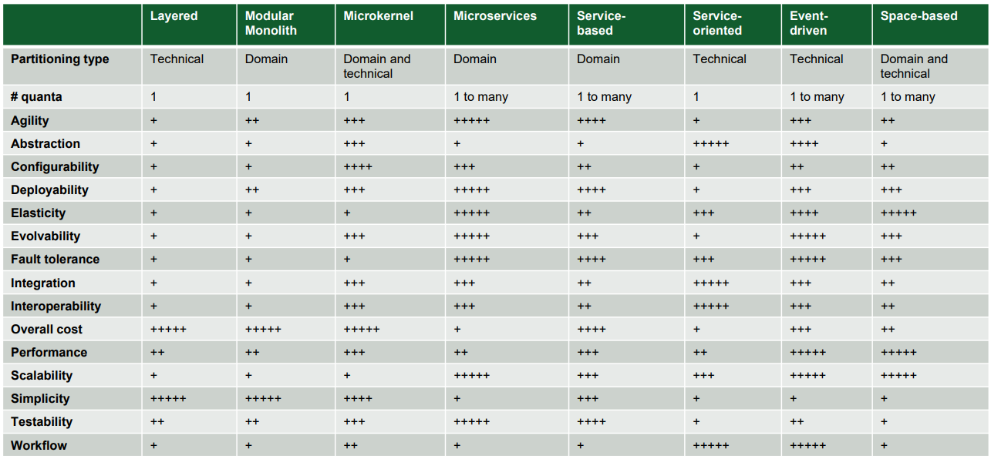

Architectural Styles | We evaluated several architectural along their strengths & weaknesses
Both Microservices & Event-Driven rank highly based on our selected characteristics
ADR 2
However, event-driven adds significant overhead due to async comms and it is technically partitioned
Microservices allow us to add changes to our system more flexibly & we will use API layers to handle request efficiently
Hence, we chose Microservices for our architectural style

Slide 8
Service Design | Overview of our Microservices
We implemented all bounded contexts as dedicated services within our TAPAS application
Advantages are higher modularity, granularity, interoperability, and scalability
Disadvantages are development complexity, service coordination & resource utilization
In this setup, we need to ensure that services can communicate with each other via an API layer with HTTP requests
ADRs 3, 4, 5, 6, 7
Client requests
Client requests
Client requests
Client requests
API layer
Task List
Roster
Executor Pool
Executor - Calculator
Executor - ChatGPT

Slide 9

Application Flow | How does an added task flow through the application and gets executed
Graphical Illustration
Explanation
No databases
1
User adds a task to the task list
2
Task List sends added task to Roster
Executor - Calculator
5
Roster
4
Executor Pool
Executor - ChatGPT
3
Roster sends request to Pool with the Task Type
3
4
Pool returns to Roster a list of executors with the right type
7
2
Task List
5
Roster sends task location (i.e., URI) to the Executor, starting execution
6
6
Executor reads user input for task from Task List
8
1
Communication over HTTPS / JSON requests
Executor executes task and updates task output & status in Task list
7
8
User can view the task output
USER

Slide 10

Software Architecture
Selected Architecture Decisions
Data Ownership & Access
Code Sharing
Dynamic Quantum Coupling
Performance & Testing
Demonstration
Key Takeaways & Contributions
Agenda

Slide 11
Data Ownership & Access | Context, Decision & Consequences
CONTEXT:
Roster needs to read capabilities on the task table (owned by the task list service).
Roster needs to read information (query) from the executor-pool table (owned by executor pool)
Executors need to perform write operations on the task table (owned by the task list).
DECISION: Single Ownership
We will define the data ownership of a specific table on the service that needs to write the operations on that specific table. With single ownership the service that writes the data becomes the data owner.
Our two services, the tasklist and the executor pool each own their respective table on the same mongodb database.
CONTEXT:
We have two services: task list service & executor pool service that need data.
Ownership of tables must be assigned to a particular service or group of services when forming a bounded context.
With the Delegate technique Task List and Executor Pool service are assigned single ownership and the roster communicates with the delegate to perform updates on its behalf.
WHY:
In our case, the two services at the moment do not even need read access on the other table they do not own.
ADR 9
via the task list service
CONSEQUENCES:
With the delegated join ownerships, we still achieve single table ownership.
Good data schema change control & abstracts data structures from other services.
Lower latency for non owning writers, which should however not be an issue in our case, as these writes happen async anyways.
Graphical Illustration
Description
We have three services that require a database: task list, executor pool & roster
Executors perform read (for task input) and write (for task output & status) to the task database via task list service
Task List
Executors
Executor Pool
Roster
Read & Write via Task List service
Read & Write
Read & Write
Read & Write
CONSEQUENCES:
Only one service is ever the owner of one specific data table.
As the two services are strictly bounded from each other also regarding their data, both become an architectural quantum.
Furthermore, we do not have any issues regarding performance, synchronization or data consistency.
Single Ownership for Task List, Executor Pool & Roster - maintain isolation of architectural quantum
Delegated Joint Ownership for Executors & Task List - maintain single ownership for Task List
No Executor database
Task Database
Pool Database
Roster Database
DECISION: Delegated Joint Ownership
Task List Table: All read and write operations are being performed via the task list service.
Executor Pool Table: Only the executor-pool needs to write to the table! The roster service that needs read permission on the table will do this via the executor-pool service.
Roster table: Single ownership. As only the roster needs write and read capabilities on it.

Slide 12


Code Sharing | Context, Decision & Consequences
ADRs 12, 13
Shared Library for Communication
Shared Library for Executors
Currently, we use a lot of standard HTTP client / server code to enable communication between microservices, leading to a lot code duplication
Our executors contain a similar code base to replicate the functionality of an executor, for instance domain logic or communication to the other microservices
We will create a separate helper class library that will help us to create more standardized HTTP requests easily
Code bundling leads to less duplication
Increased complications & efforts for version mgmt.
We will build a separate executor library that implements the common functionality across executors (i.e., everything that is not executor-specific)
Changes on common functionality of executors implemented at a single place
Increased complications & efforts for version mgmt.

Slide 13



Dynamic Quantum Coupling | Context, Decision & Consequences
ADR 11
Communication
Consistency
Coordination
In our current architecture, microservices communicate via synchronous HTTP calls, leading to dynamic quantum entanglement
We maintain consistency across our microservices in our architecture through events (e.g., status updates)
Currently, we have not implemented an orchestrator – once a task is added to the list, the info / action moves from one service to the next
Moving to async communication between our microservices (especially for the Executor) will lead to:
Highly decoupled systems
Higher performance & scale
Harder code to build / debug
To maintain eventual consistency, we need to synchronize data into consistent state (e.g., Task updates)
More resilient to NW failures
Higher scalability
Harder code to manage / debug
We will focus on choreography (vs. orchestration) as our fundamental coordination pattern
Higher scalability, fault tolerance and responsiveness
More difficult state mgmt.

Slide 14
Software Architecture
Selected Architecture Decisions
Performance & Testing
JMeter
ChaosMonkey
Demonstration
Key Takeaways & Contributions
Agenda

Slide 15

JMeter | We ran the following tests
Local Environment (with docker)
1
Deep-dive on next pages
Throughput Analysis with POST tasks requests
Without cache clearance
2
Throughput Analysis with POST and GET tasks request
Without cache clearance
With cache clearance
3
Throughput Analysis with GET roster request
Without cache clearance
VM Environment
Analysis Application: https://jmeter.streamlit.app/
4
Throughput Analysis with POST and GET tasks request
Without cache clearance

Slide 16
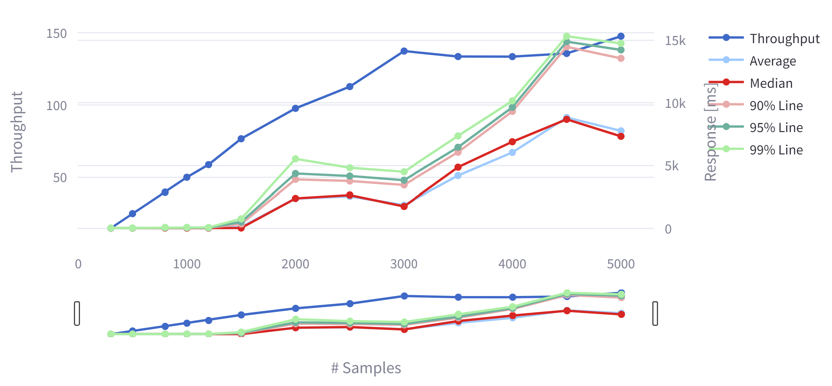
JMeter | POST Task Request, Local, Without Cache Clearance
Throughput stagnates with 3'000 threads
8% Errors with 5'000 threads, no issues before
Test parameters
Threads: 300-5000 | Ramp-Up Period: 20 sec | Type: GREETING

Slide 17
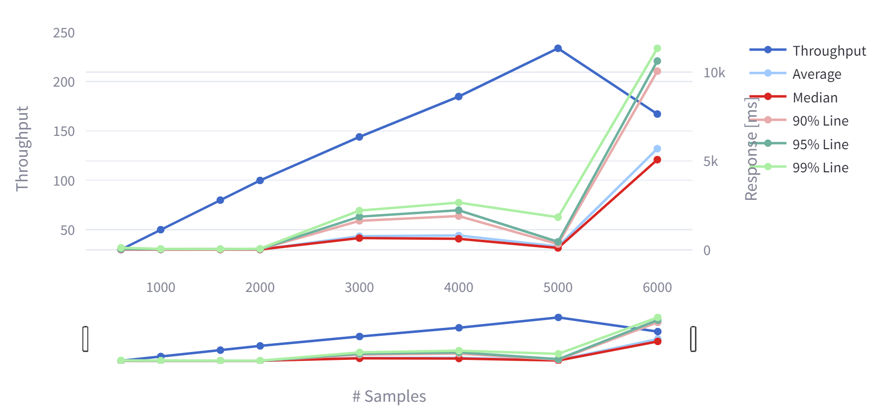
JMeter | POST & GET Task Request, Local, Without Cache Clearance
Linear behaviour until 5'000 threads seems a bit suspicious
2.5% Errors starting at 1'600 Samples and increase fast from 4'000 samples onwards
Test parameters
Threads: 300-6000 | Ramp-Up Period: 20 sec | Type: GREETING

Slide 18
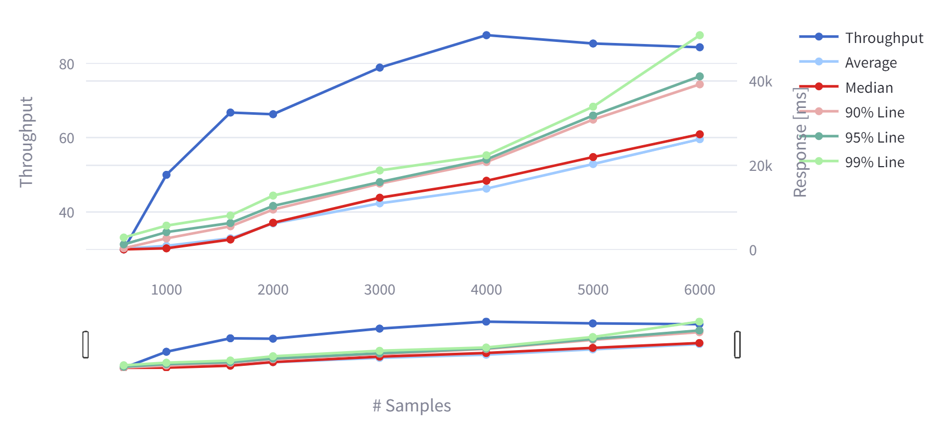
JMeter | POST & GET Task Request, Local, With Cache Clearance
Cache clearance before the test slows down the response time around factor 4
Cold Start of Docker
Database vs. Cache
Test parameters
Threads: 300-6000 | Ramp-Up Period: 20 sec | Type: GREETING

Slide 19

ChaosMonkey | TAPAS Chaos Testing
Roster
Latency Assault: Delays in task execution.
Exception Assault: Delay & possible breakdown of application.
Most vulnerable service. Robust fault-tolerance needed to prevent application breakdown.
Executor - Calculator
Roster
Executor Pool
Executor - ChatGPT
Executor Pool
Task List
​Exception Assault: Failure to match and assign executors. Causes Task backlog. Possible eventual breakdown of application.
Latency Assault
Executor Calculator
Exception Assault
Exception Assault: Failure to execute tasks. Task List is also not notified of failure.​
Circuit Breaker: Fallback method to notify task list of task execution failure.
USER
Circuit Breaker

Slide 20
Software Architecture
Selected Architecture Decisions
Performance & Testing
Demonstration
Key Takeaways & Contributions
Agenda

Slide 21


Demonstration | We will show you 2 different executors in action
Calculator
«Sassy» Coding Copilot

Slide 22
Software Architecture
Selected Architecture Decisions
Performance & Testing
Demonstration
Key Takeaways & Contributions
Troubles & Learning
Contributions
Agenda

Slide 23


Key Takeaways | Troubles & Learning
Troubles
Hexagonal and the Microservices Architecture
Deployment on Docker
Compilation Issues
Performance Testing, e.g., JMeter
….
Learning
Communication between microservices
Getting more familiar with testing
Experience with non-relational databases
Improved collaboration with GitHub / Trello
…

Slide 24
Contributions | We were able to distribute the group work quite fairly within our team
Kaan
Michael
Daniel
Stephan
Task List
Executor Pool
Executors
Roster
Testing
Performance
Documentation

Slide 25
Any questions?

